Slide 1
pfstools

Slide 2
Contents
Image Set for generation of HDR image.
How pfstools can be use to
Estimate Response Curve
Generate HDR Images
Tone mapping
Time Analysis
OpenCV vs pfstools

Slide 3
Image Set
Standard Image Sets have been used, these include images with varying exposures.
Images containing interior parts of Madison Capitol have been considered.
Furthermore high definition images of MacBeth Color Checker and Toy Shuttle are taken into account.
Six such different image sets have been operated upon.

Slide 4
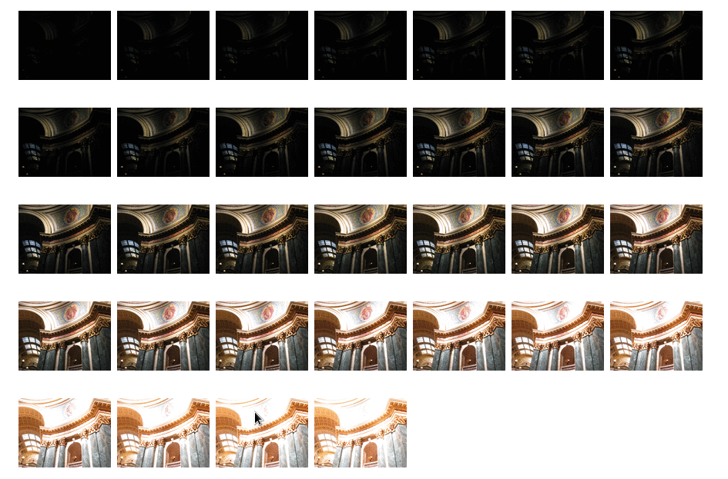
Sample Image Set

Slide 5
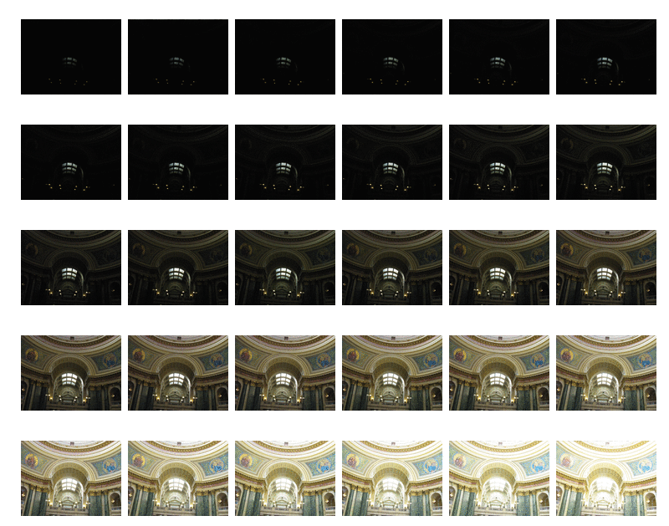
Sample Image Set (2)

Slide 6
HDR Imaging
Using certain pfstools commands these 'jpg' format images are converted to hdr image.
pfshdrcalibrate − Create an HDR image or calibrate a response curve from a set of differently exposed images supplied in PFS stream.
pfsinme *.JPG | pfshdrcalibrate -v -s response.m | pfsout xyz.hdr
Recover the response curve from set of all JPEG files in the current directory and save it to response.m file.
This command considers the exposure time, aperture value, focal length and other properties of each image in order to generate an HDR picture.

Slide 7

Command Execution
This command considers jpg format files, generates response curve 'response.m' and saves the hdr image in 'xyz.hdr'

Slide 8
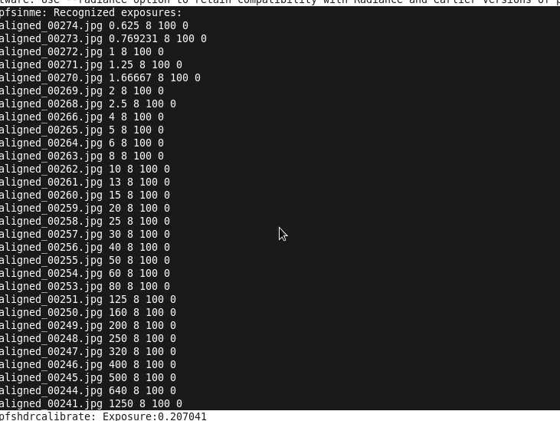
Image Recognition

Slide 9
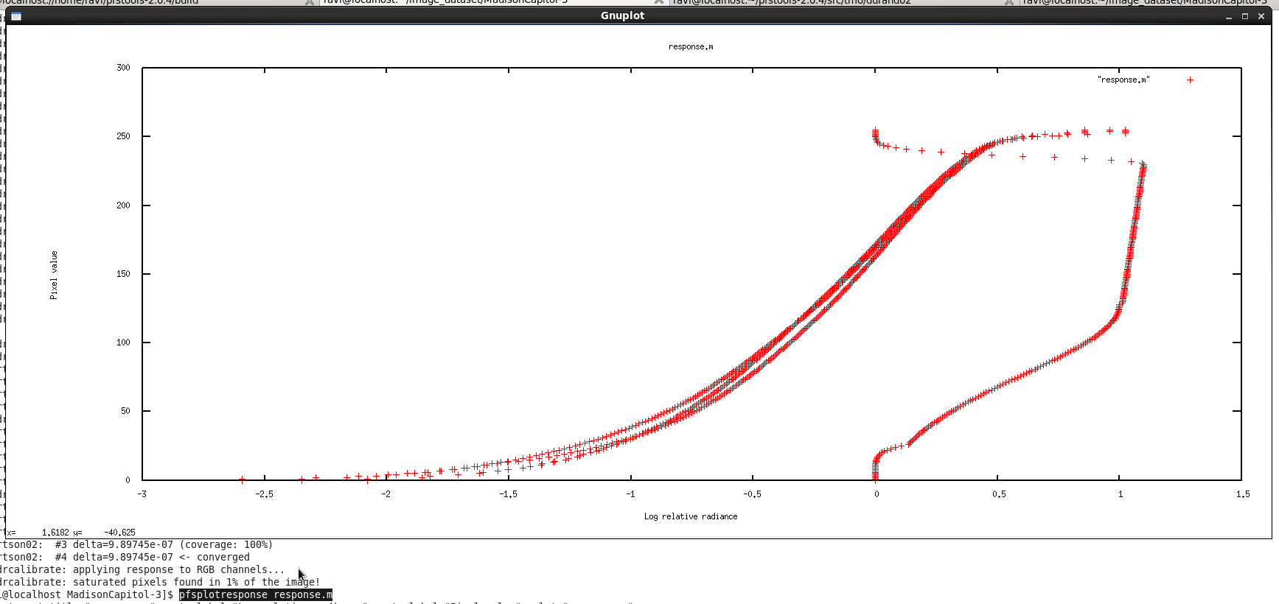
Estimating Response Curve

Slide 10
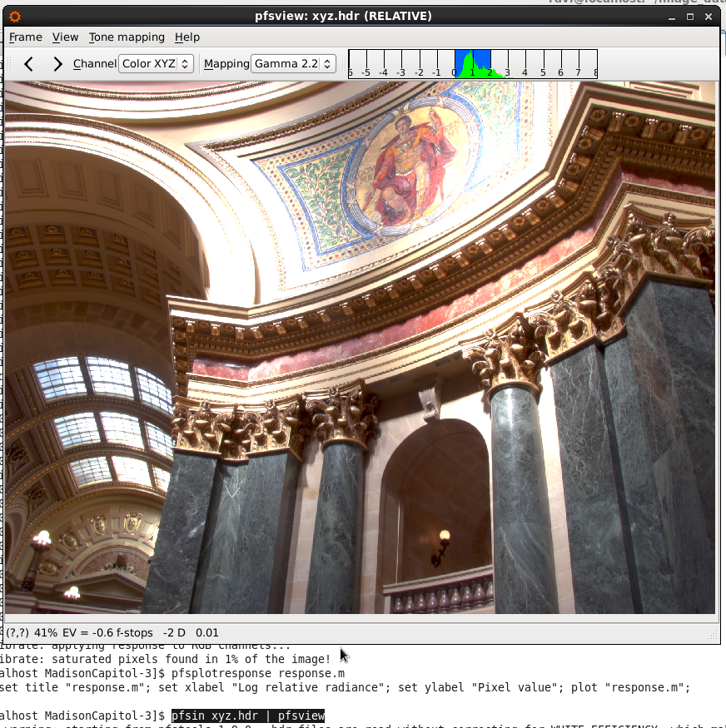
Resulting HDR Image

Slide 11
Tone Mapping
Tone mapping is a technique used in image processing and computer graphics to map one set of colors to another to approximate the appearance of high-dynamic-range images in a medium that has a more limited dynamic range.
Here we use durand tone mapping operator in order to generate a png image from the HDR picture.
We analyze the time taken by pfstools in order to do so.

Slide 12
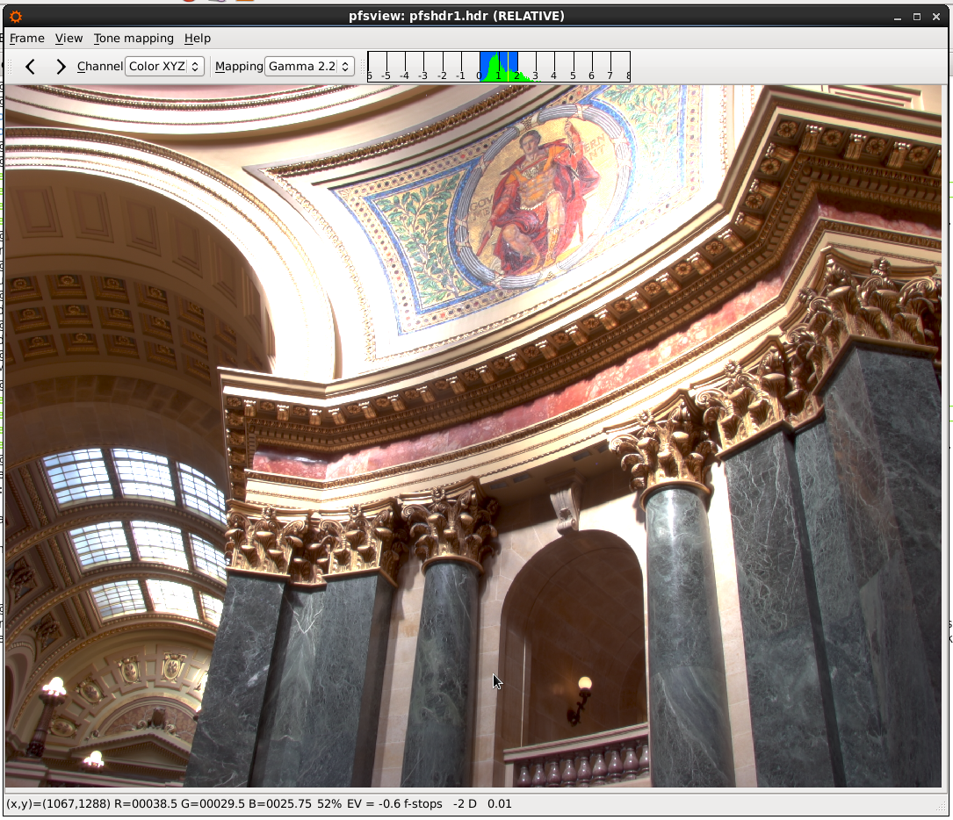
Sample HDR to png conversion
HDR image Madison Capitol

Slide 13

Command Execution
This command takes in as input the above mentioned hdr image 'pfshdr1.hdr', applies durand tone mapping, gamma correction and gives 'zyx.png' as output.

Slide 14
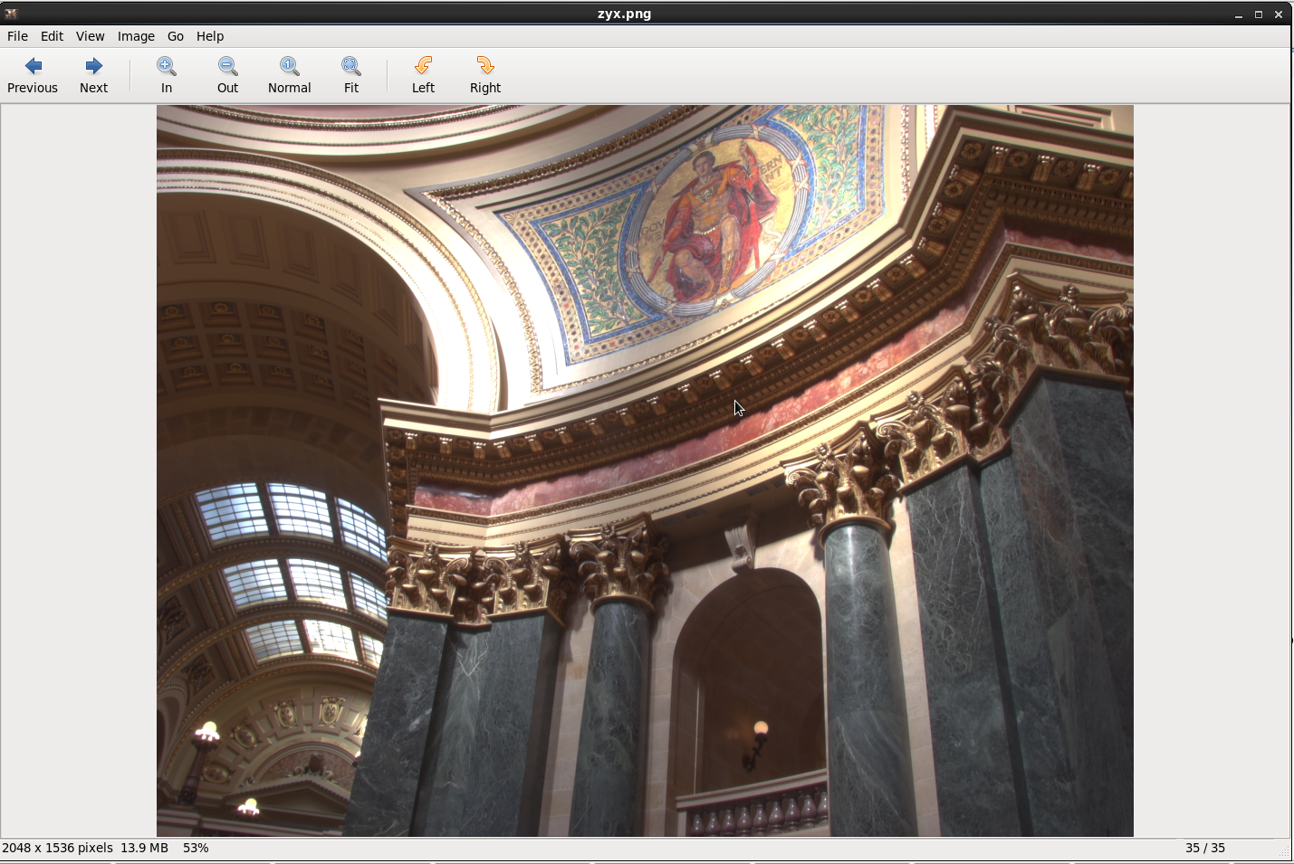
Tone Mapped Image

Slide 15
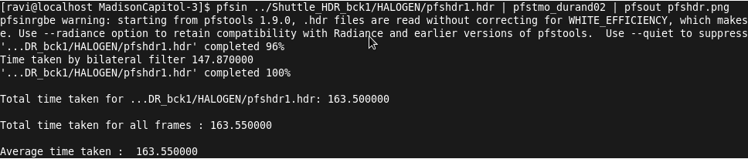
Time Analysis
We analyze the time taken by durand tone mapping operator on different hdr images.
Time taken for 5184x3456 hdr image

Slide 16
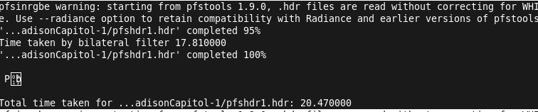
Time to tone map 2048x1536 hdr image (6)

Slide 17
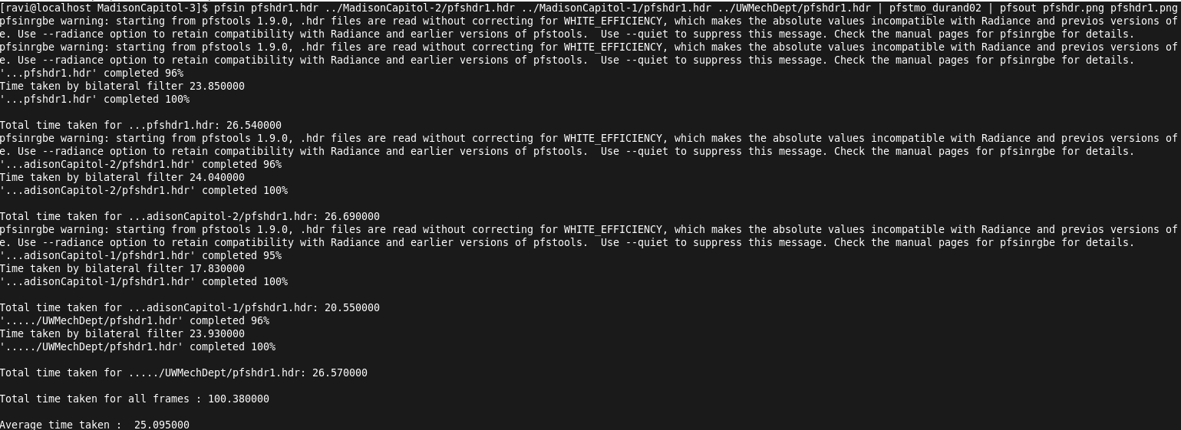
Average time for four hdr images (2048x1536).

Slide 18
Comparison
We take a set of jpg images and apply OpenCV , pfstools commands in order to compare the two.
The standard image set described above considering the interior of Madison Capitol has been used.
The comparison results are described in the next slide.

Slide 19
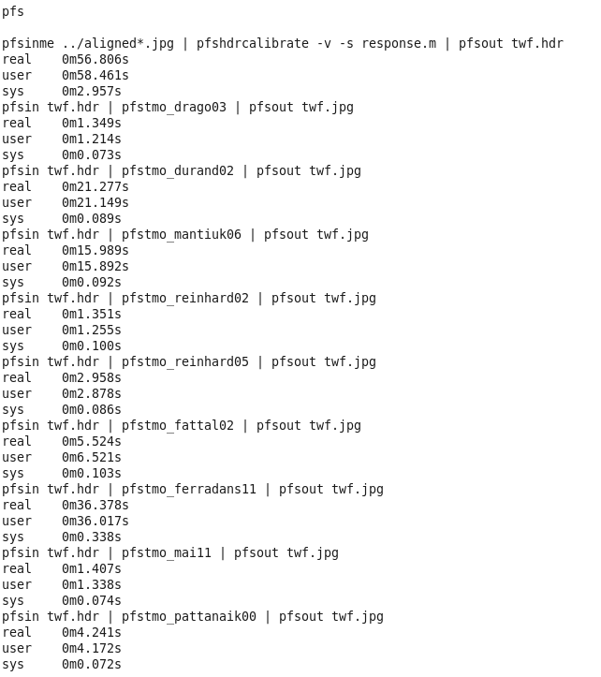
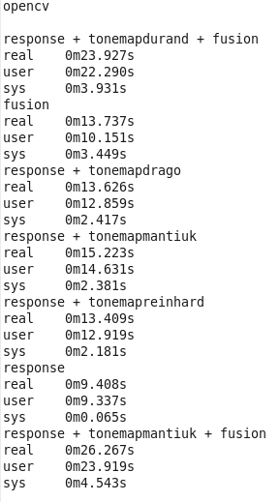
OpenCV vs pfstools

Slide 20
References
http://pfstools.sourceforge.net/index.html
http://pages.cs.wisc.edu/~csverma/CS766_09/HDRI/hdr.html
http://eidomatica.di.unimi.it/index.php/research/idb/yaccd2
http://docs.opencv.org/3.0-beta/doc/tutorials/photo/hdr_imaging/hdr_imaging.html

